Slide 1



Lecture 3b
Pooling Layers
Master in Big Data Solutions 2020-2021 - Artificial Intelligence
Xavier Giró
xavier.giro@bts.tech

Slide 2

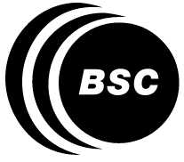


Acknowledgements
Míriam Bellver
miriam.bellver@bsc.edu
PhD Candidate
Barcelona Supercomputing Center
Kevin McGuinness
kevin.mcguinness@dcu.ie
Research Fellow
Insight Centre for Data Analytics
Dublin City University

Slide 3
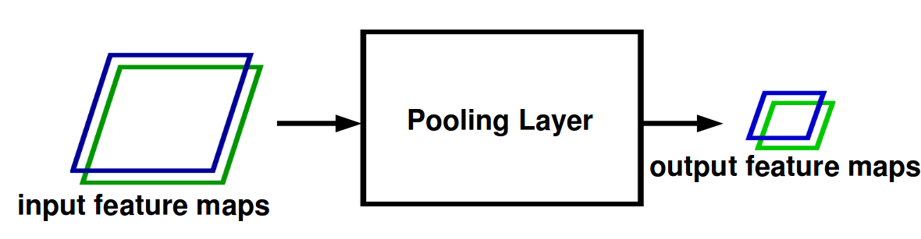
Pooling Layer
Pooling is a downsample operation that operates in the same dimensions of the convolutions.
Figure Credit: Ranzatto

Slide 4

Pooling Layer
Figure Credit, CS231n Course

Slide 5
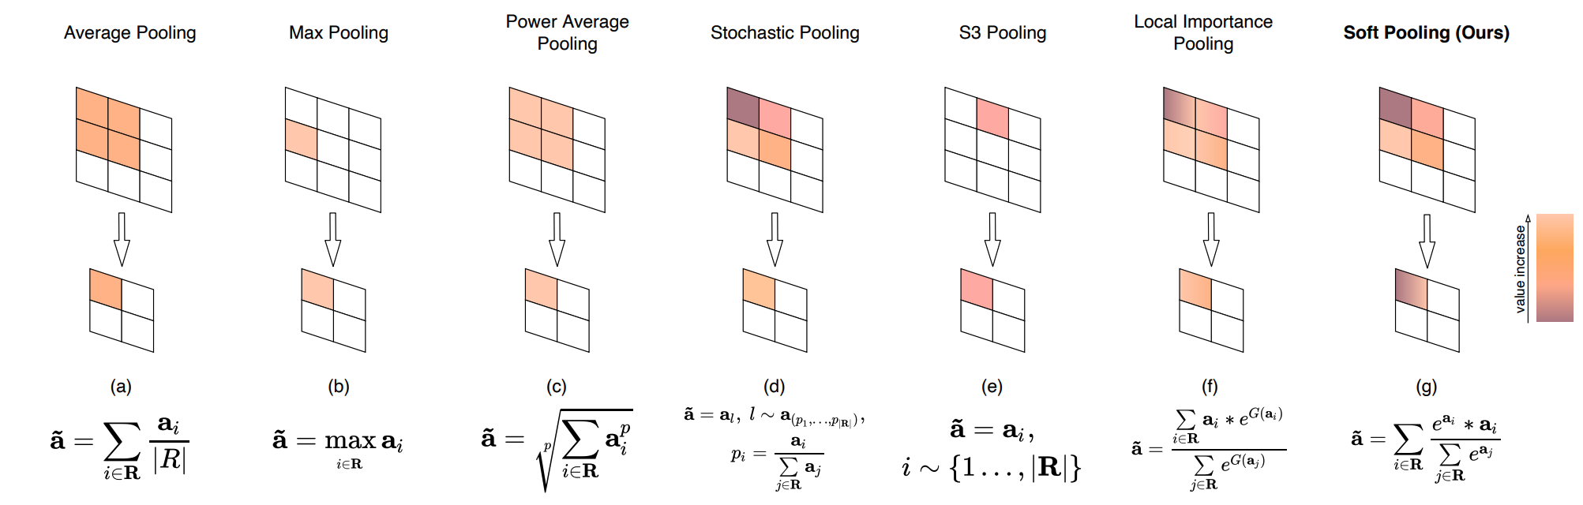
Pooling Schemes
The Most Popular
#SoftPool Stergiou, Alexandros, Ronald Poppe, and Grigorios Kalliatakis. "Refining activation downsampling with SoftPool." arXiv preprint arXiv:2101.00440 (2021). [tweet]
Notes:
Figure 2. Pooling variants. We simplify the equations by using R for representing the width and height dimensions. (a,b) average and maximum pooling are based on averaging and maximum activation selection in a kernel. (c) Power Average pooling (Lp) [8, 13] is proportional to average pooling raised to a power (p), with the output being equal to max-pool (p → ∞) or sum pooling (p = 1). (d) Stochastic pooling [46] outputs a randomly selected activation from the kernel region. (e) Stochastic Spatial Sampling (S3Pool) [47] samples random horizontal and vertical regions given a specified stride. (f) Local Importance Pooling (LIP) [10] uses a trainable function G to enhance specific features. (g) Softpool (ours) exponentially weighs the effect of activations using a softmax kernel.

Slide 6

Pooling Schemes: Max Pooling
Figure: CS231n Stanford University

Slide 7
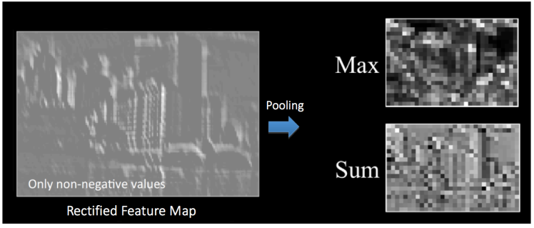
Pooling Schemes: Max & Average (Sum) Pooling
Figure: Fergus, Lee, Ranzato, Salakhutdinov, Taylor, Yu, Deep Learning Methods for Vision, CVPR 2012.

Slide 8

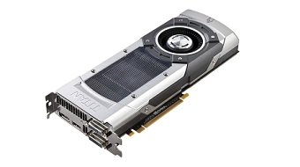
Pooling Layer
The reduction in the size of the feature maps reduces the computation requirements.

Slide 9
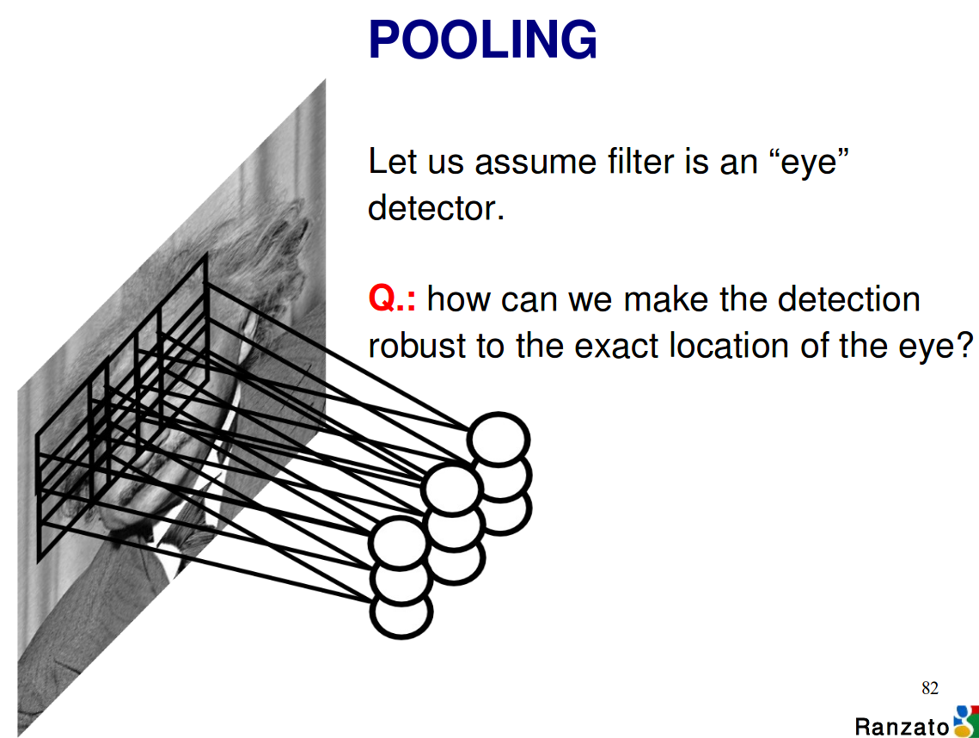
Pooling Layer
Assume that the 2D convolutional filter is an “eye” detector. What is the effect of pooling the outputs of this “eye” detector over nearby pixels ?
Slide concept & Figure: Ranzatto

Slide 10
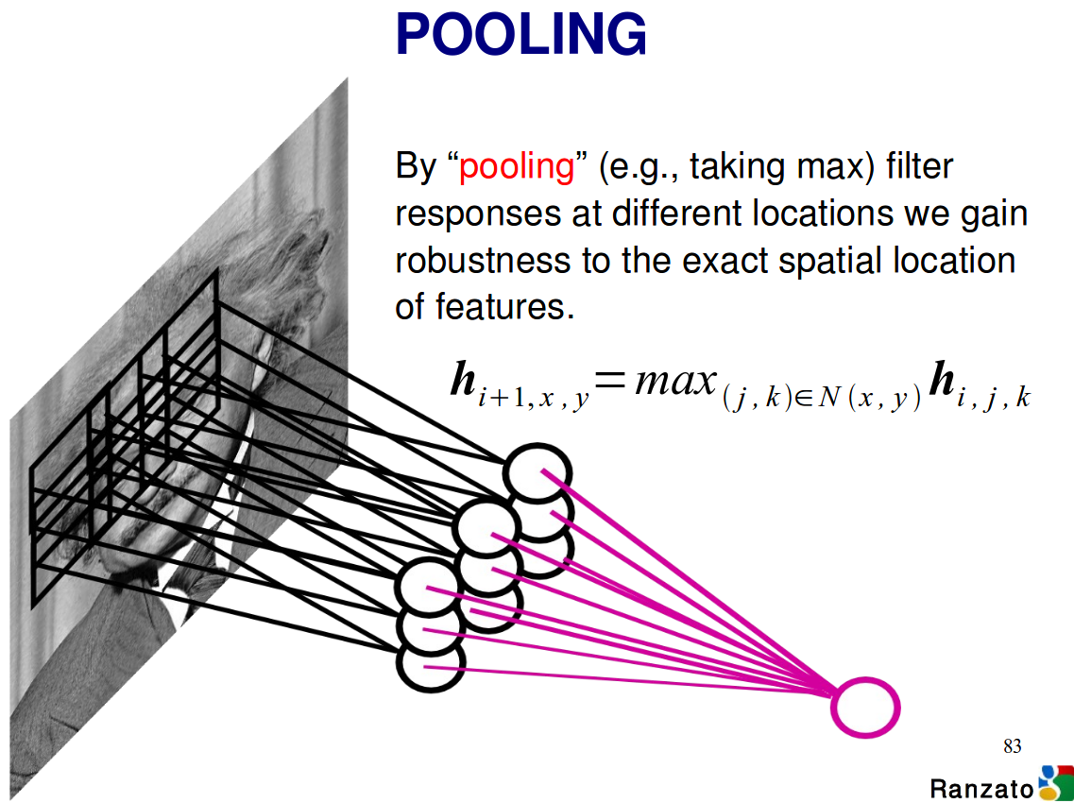
Pooling Layer
Assume that the 2D convolutional filter is an “eye” detector. What is the effect of pooling the outputs of this “eye” detector over nearby pixels ?
Slide concept & Figure: Ranzatto

Slide 11
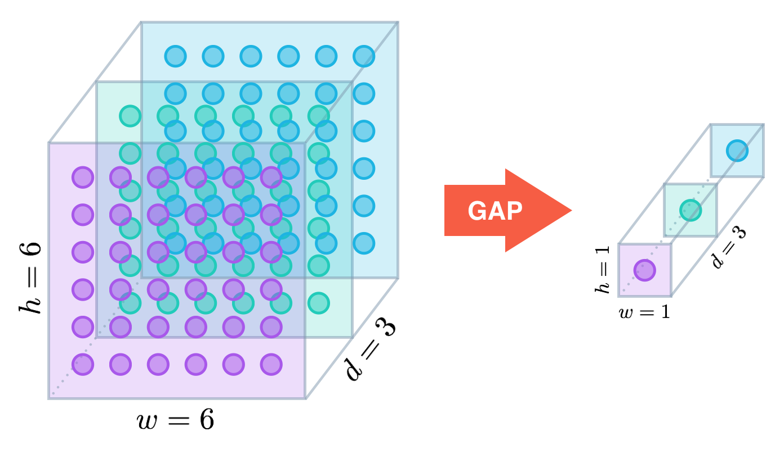
Global Pooling
Collapse to 1D-dimensions by applying a pooling operation over channels.
Global Average Pooling
Figure:
Alexis Cook
#NiN Lin, Min, Qiang Chen, and Shuicheng Yan. "Network in network." ICLR 2014.

Slide 12
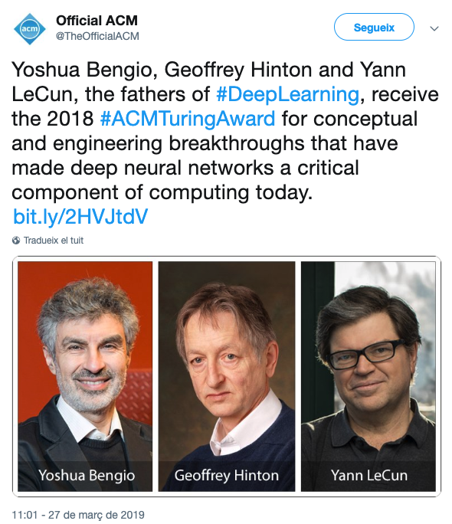
Pooling Layer (critics)
"The pooling operation used in CNNs is a big mistake and the fact that it works so well is a disaster."
Geoffrey Hinton,
AMA reddit (2015).
Learn more:
Richard Zhang, “Making Convolutional Networks Shift-Invariant Again” (ICML 2019)

Slide 13
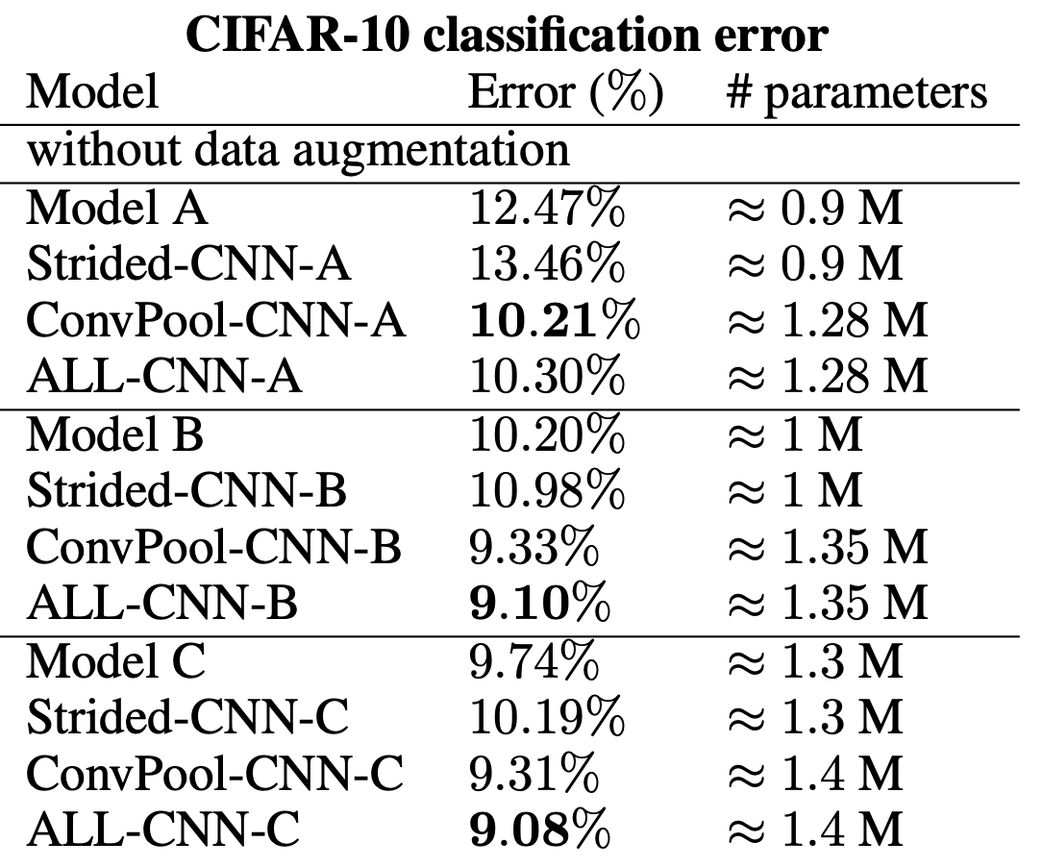
Pooling Layer (critics)
“We find that max-pooling can simply be replaced by a convolutional layer with increased stride without loss in accuracy on several image recognition benchmarks.”
Springenberg, J. T., Dosovitskiy, A., Brox, T., & Riedmiller, M.. Striving for Simplicity: The All Convolutional Net. ICLR 2015

Slide 14
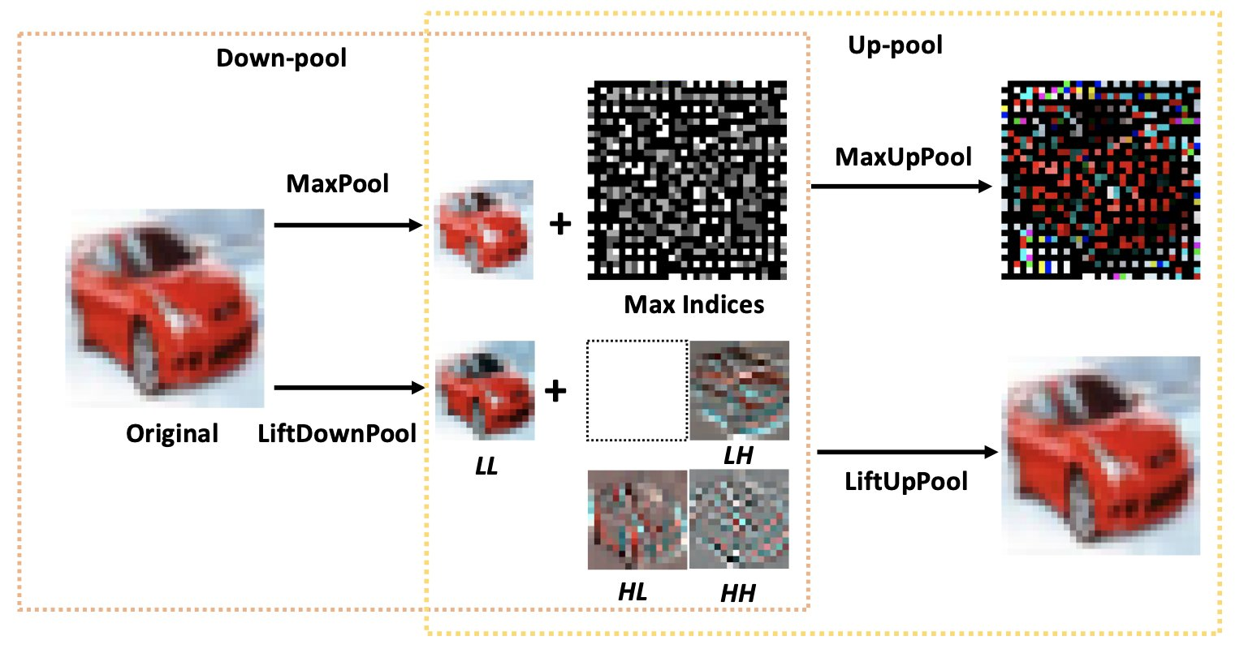
Invertible Pooling
#LiftPool Zhao, Jiaojiao, and Cees GM Snoek. "LiftPool: Bidirectional Convnet Pooling." ICLR 2021. [Tweet]
Notes:
Pooling is a critical operation in convolutional neural networks for increasing receptive fields and improving robustness to input variations. Most existing pooling operations downsample the feature maps, which is a lossy process. Moreover, they are not invertible: upsampling a downscaled feature map can not recover the lost information in the downsampling. By adopting the philosophy of the classical Lifting Scheme from signal processing, we propose LiftPool for bidirectional pooling layers, including LiftDownPool and LiftUpPool. LiftDownPool decomposes a feature map into various downsized sub-bands, each of which contains information with different frequencies. As the pooling function in LiftDownPool is perfectly invertible, by performing LiftDownPool backward, a corresponding up-pooling layer LiftUpPool is able to generate a refined upsampled feature map using the detail subbands, which is useful for image-to-image translation challenges. Experiments show the proposed methods achieve better results on image classification and semantic segmentation, using various backbones. Moreover, LiftDownPool offers better robustness to input corruptions and perturbations.

Slide 15


